Slide 1
Triggers & Refactoring
Rob Vatz
Email : rob.vatz@sceneralabs.com
Notes:
I’ve been exploring the idea of refactoring a database. To do so, I realized I needed to learn about triggers. I’d thought I’d share what I’ve learned.

Slide 2
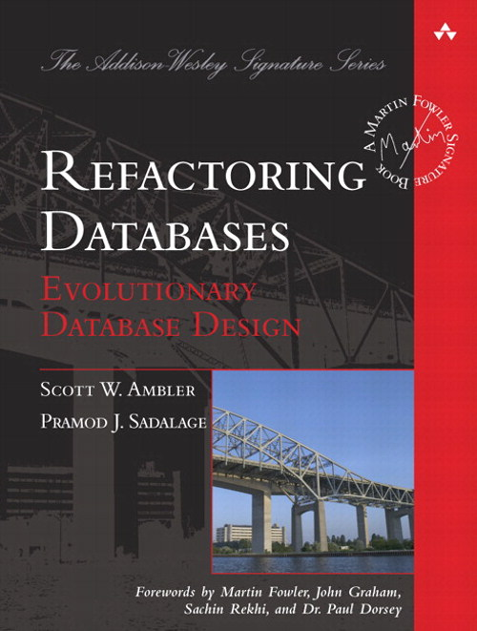
Refactoring Databases Book
Notes:
This is the idea of gradually changing your database design as you learn requirements . It fits in well with current programming trends such as Agile and Lean, which emphasize Minimum Viable Product, and experimentation

Slide 3
Refactoring Database
Expand
Convert/copy data and add triggers
Migrate
Remove triggers
Contract
Notes:
Refactoring a database consists of essentially 3 steps: expand, migrate, and contract.

Slide 4
Expand
Add tables
Add columns
Add DEFAULT constraints
Remove UNIQUE, FOREIGN KEY, PRIMARY KEY constraints
Remove CHECK constraints
Notes:
optional

Slide 5
Migrate
Add/Change/Remove stored procedures and functions to use new version
Developers change their code to use new version
Notes:
The triggers keep the two versions in sync.

Slide 6
Contract
Remove tables
Remove columns
Remove DEFAULT constraints
Add UNIQUE, FOREIGN KEY, PRIMARY KEY constraints
Add CHECK constraints
Notes:
Contract (optional) – the opposite of expand. (Rename instead of drop if you’re really cautious.)

Slide 7
Demo
Notes:
Setup, show OLD table
Show goals of refactor

Slide 8
Lessons Learned
SET RECURSIVE_TRIGGERS OFF/ON
Triggers execute even if table contents doesn’t change
Testing is painful, especially setup, so…
Have a test script
Use version control
Notes:
Lessons learned
Discovered the RECURSIVE_TRIGGER option. By default, It’s off. Learned what happens when it’s on, namely…
Triggers execute even if no rows are changed.
Setting up a test is a lot of work, so have a test script.
-- Lessons learned:
-- 1. Automated unit tests is a good idea: you back up and start all over a lot
-- You need to cover all cases: INSERT/UPDATE; old/new.
-- 2. Because of lesson #1, version control is probably a good idea
-- 3. Changelog table was a good debugging tool
-- 4. Need "WHERE Customer.CustomerId = inserted.CustomerId" clause to keep from
-- from changing every row. Tests probably need to verify all rows.
-- 5. LEFT OUTER JOIN needed, so ISNULL(deleted.column,...) needed in WHERE clauses.
-- Both needed to handle INSERT situation.
-- 6. An UPDATE that changes no rows still invokes the trigger. Without an IF at the
-- top, the trigger will go into infinite recursion. Alternatively, setting the
-- database "ALTER DATABASE Demo1 SET RECURSIVE_TRIGGERS OFF" also works. (OFF
-- is the default setting.)

Slide 9
References
Evolutionary Database Design: http://martinfowler.com/articles/evodb.html
Expand/Contract pattern: http://martinfowler.com/bliki/ParallelChange.html
Refactoring Databases book

Slide 10
Questions?

